Slide 1
F23:Acute and transient psychotic disorder

Slide 2
Clinical description: According to ICD-10
Are a group of conditions characterized by three typical features in the descending order of priority:
These disorders have an abrupt (less than 48 hours) or an acute onset (within 2 weeks) as the defining feature of the whole group.
Presence of typical syndromes
Presence of associated acute stress

Slide 3
Clinical description
Acute onset: Is defined as a change from a state without psychotic features to a clearly abnormal psychotic state, within a period of 2 weeks or less.
There is some evidence that acute onset is associated with a good outcome, and it may be that the more abrupt the onset, the better the outcome.
It is therefore recommended that, whenever appropriate, abrupt onset(within 48 hours or less) be specified.

Slide 4
Contd..
The typical syndromes that have been selected are first, the rapidly changing and variable state, called here “polymorphic”, that has been given prominence in acute psychotic states in several countries, and second, the presence of typical schizophrenic symptoms.

Slide 5
Contd..
Associated stress is taken to mean that the first psychotic symptoms occur within about 2 weeks of one or more events that would be regarded as stressful to most people in similar circumstances, within the culture of the person concerned.
Typical events would be bereavement, unexpected loss or partner or job, marriage, or the psychological trauma of combat, terrorism and torture.
Long standing difficulties or problems should not be included as a source or stress in this context.

Slide 6
Contd..
Complete recovery usually occurs within 2 to 3 months, often within a few weeks or even days, and only a small proportion of patients with these disorders develop persistent and disabling states.
More in females than in males.
Can occur at any age but peak in mid thirties

Slide 7
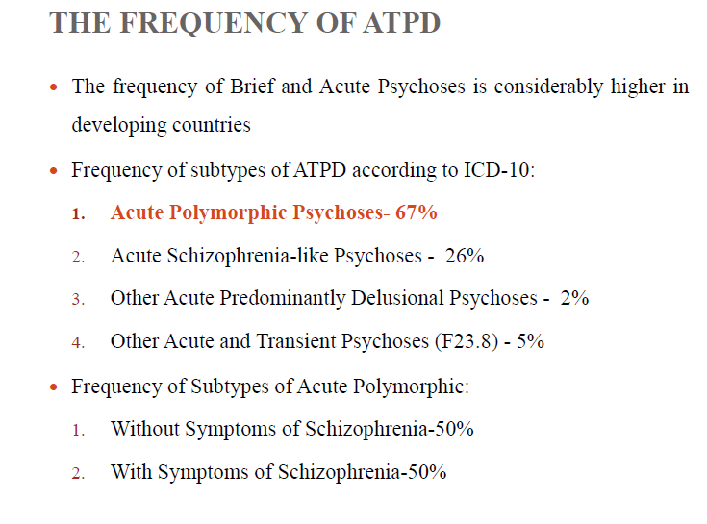

Slide 8
TYPES
Acute polymorphic psychotic disorder without symptoms of schizophrenia.
Acute polymorphic psychotic disorder with symptoms of schizophrenia.
Acute schizophrenia- like psychotic disorder.
Other acute predominantly delusional psychotic disorders.

Slide 9
ACUTE POLYMORPHIC PSYCHOTIC DISORDER WITHOUT SYMPTOMS OF SCHIZOPHRENIA
Acute onset within 2 weeks(from non-psychotic to psychotic state).
• Polymorphic picture(unstable and markedly variable clinical picture that changes from day to day or hour to hour).
• Several types of hallucinations and/or delusions, changing in both type or intensity from day to day or within the same day.
• Marked emotional turmoil(intense feelings of happiness & ecstasy to anxiety & irritability).

Slide 10
ACUTE POLYMORPHIC PSYCHOTIC DISORDER WITH SYMPTOMS OF SCHIZOPHRENIA
Meets the descriptive criteria for acute polymorphic psychotic disorder but in which typically schizophrenic symptoms are also consistently present.
• If schizophrenic symptoms persist for > 1 month, diagnosis changed to schizophrenia.

Slide 11
ACUTE SCHIZOPHRENIA-LIKE PSYCHOTIC DISORDER
Characterised by acute onset of a psychotic disorder in which psychotic symptoms are comparatively stable(& not polymorphic) & fulfill the criteria for schizophrenia but have lasted for < 1month.

Slide 12
OTHER ACUTE PREDOMINANTLY DELUSIONAL PSYCHOTIC DISORDERS
• Acute onset of a psychotic disorder in which comparatively stable delusions or hallucinations are the main clinical features but do not fulfill the criteria for schizophrenia.
• Delusions of persecution or reference are common & hallucinations are usually auditory.
• Criteria for acute polymorphic psychotic disorder or schizophrenia should not be fulfilled.

Slide 13
F23.8 Other acute and transient psychotic disorders
Any other acute psychotic disorders that are unclassifiable under any other category in F23 (such as acute psychotic states in which definite delusions or hallucinations occur but persist for only small proportions of the time) should be coded here.
States of undifferentiated excitement should also be coded here if more detailed information about the patient's mental state is not available, provided that there is no evidence of an organic cause.
F23.9 Acute and transient psychotic disorder, unspecified
Includes: (brief) reactive psychosis NOS

Slide 14
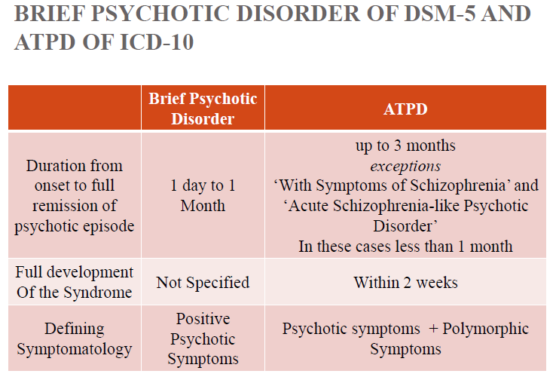

Slide 15
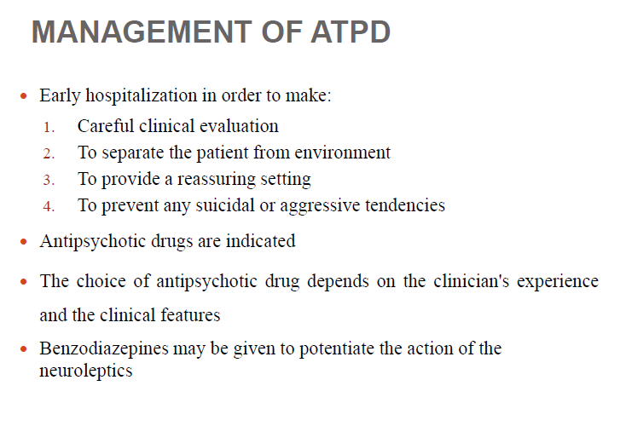

Slide 16
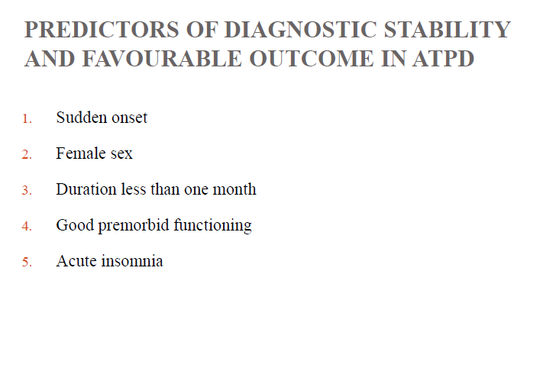

Slide 17
Nursing management
Nursing assessment
Nursing diagnosis
Nursing intervention

Slide 18
Nursing diagnosis
Disturbed thought process.
Disturbed sensory perception: Auditory/visual
Impaired social interaction.
Impaired verbal communication.
Defensive coping.
Interrupted family coping.

Slide 19
Nursing intervention
Reorient the client to time, place and person.
Be consistent in setting expectations, enforcing rules, and so forth.
Reduce provocative stimuli, negative criticism, arguments, and confrontation.
Identify specific conflicts that remains unresolved, and assist patient to identify possible solutions.
Use touch cautiously, particularly if thoughts reveal ideas of persecution.
Engage the patient in one-to-one activities first, then activities in small groups, and gradually in large groups.
Teach patient to intervene, using thought-stopping techniques, when irrational or negative thoughts prevail.

Slide 20
Keep environment calm, quiet and as free of stimuli as possible.
Use simple, concrete, and literal explanations.
Use simple words, and keep directions simple as well.
Plan short, frequent periods with a client throughout the day.
Use therapeutic techniques (clarifying feelings when speech and thoughts are disorganized) to try to understand client’s concerns.

Slide 21
Inform the client family in clear, simple terms about psychopharmacologic therapy.
Identify’s family’s ability to cope.
Teach the client and family the warning symptoms of relapse. provide information on disease and treatment strategies at family’s level of understanding.
Provide information on client and family community resources for the client and family after discharge : organizations, psychoeducational programs, community respite centers, etc

